Slide 1
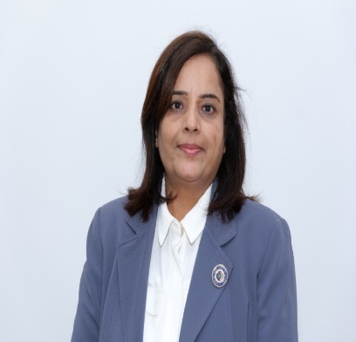
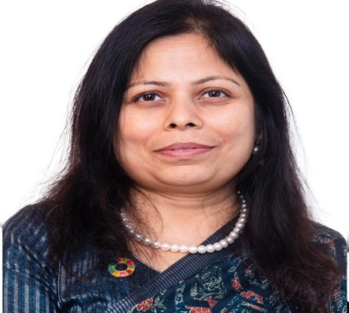
The Institute of Chartered Accountants of India (Set up by an Act of Parliament)
Women Members Excellence Committee
Organises
यशस्विनी - An IDOL- Live Webinar
CA. Priti Paras Savla
Chairperson, WMEC, ICAI
CA. Kemisha Soni
Vice Chairperson, WMEC, ICAI

Slide 2
_{GLOBAL SERVICE/ INDUSTRY}
“Be the Change”
Presenter: Bhavna Doshi
Place Presentation Title Here
AUDIT / TAX / ADVISORY / LINE OF BUSINESS
Name Designation Discipline City Date of Meeting
Women Members Excellence Committee
Webinar - "यशस्विनी - An IDOL"
20 March, 2024

Slide 3
The Change….and, its ever increasing pace

Slide 4
Around us ……
India, a developed nation by 2047…
India, a $ 5 Trillion, $ 10 Trillion….economy…
……………….
India, one in every 3rd CA, a woman….
And, the space of AI

Slide 5
India’s Economy ……
“ Already here we are. Up and running, moving from Kaun Banega Crorepati to Kaun Banega $ 10 Trillion economy”
- Ananya Birla at recent ET Awards Function for
Corporate Excellence

Slide 6
Change is the only constant ……
Lot is changing around us…
And, we too have embraced change !
What more ?

Slide 7
…Question is…
Are we just flowing with change….just to remain relevant .. Happy in own comfort zone?
Or, have we changed ?
Gone beyond
Been Proactive

Slide 8
Going beyond…
Yes, would like to …….leapfrog
But….but……….but…. Wherewithal ?
If…….

Slide 9
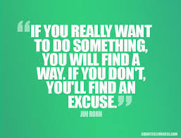
The will to achieve…..

Slide 10
Remember…
For us, key to success always was and will remain:
Delivering quality service, in cost effective manner.

Slide 11
What and how to change…
Determinants
Our strengths – core and more learnt, mastered….
Our Clientele – base and changing….

Slide 12
What and how to change…
Determinants
Our strengths
What are we:
Finder,
Minder or
Grinder

Slide 13
What and how to change…
Determinants
Our Clientele
What do they need:
Standardised
Specialised

Slide 14
Imagine
“I cannot teach anybody anything. I can only make them think”
- Socrates

Slide 15
“Be the Change”

Slide 16
Several Indians Leading…..

Slide 17
Thank You

